Slide 1
Sec filings and three-CARD Monte
Some of Our Favorite Tricks of the Trade
Michelle Leder
Footnoted.com
ml@footnoted.com
@footnoted

Slide 2
At a glance:
Companies use all sorts of tricks to get you to ignore their routine SEC filings and instead pay attention to the things they want you to focus on (investor days, conference calls, etc)
Some of these tricks seem downright silly, and yet they still happen every day.
Remember: filings are written by lawyers who get paid by the word!
After 10 years of reading filings, we’ve pretty much seen it all!
Notes:
Just like three-card monte….Going to talk about some of our favorite tricks, but not an exhaustive list.

Slide 3
Strategy: Same filing/same day
On June 5, Thermo-Fisher announced a $2.2 billion secondary offering, in part to finance its $15.8 billion purchase of Life Technologies
In an 8-K talking about the proceeds, the company also disclosed that it was likely to receive a “second request” from the FTC related to the merger.
Two days later (at 5:17 pm on a Friday), Life Technologies filed its own 8-K noting that it had received the “second request”.
Notes:
This was a bit trickier because this actually impacted 2 companies and all I can say is that the paper trail that happens after 2 companies merge can be pretty intense and tricky to follow

Slide 4
Strategy: Multiple filings/same day
On April 18, Microsoft announced record earnings shortly after the market closed.
Release noted that CFO would be leaving, but provided no details.
A few minutes later (at 4:07) Microsoft files its 10-Q
One hour later, company files resignation agreement with Peter Klein that pays him $1 million
Total pages filed over course of 1 hour: 85

Slide 5
Strategy: flood the zone
One day flood:
On June 17, Weyerhauser filed 4 separate 8-Ks and 2 other filings and did a “special presentation” for investors
Total page count: >350 pages
Multiple flooding incidents:
In month of May, Meritor filed 6 8-Ks, an amended 10-K, a 10-Q and a few other things.
During the prior 2 Mays, it filed just 1 8-K!
Total page count: >500 pages

Slide 6
The Friday Night Dump
Last Friday (June 14), there were 101 8-Ks filed
44 of them were filed after 4 pm
Typical number is 9% of all 8-Ks filed in any given week are filed after 4 pm on a Friday
Pre-holiday weekends even worse.

Slide 7
The Monday morning dump
The SEC electronic window closes at 5:30:59 on a Friday. Anything filed after that is automatically held until first-thing Monday morning
We’ve seen companies filing at 8 or 9 pm on a Friday, so the filing date reflects Monday.
On May 31, Tutor Perini filed this 8-K at 7:07 pm.

Slide 8
The forward-looking statement dump
We’ve noticed a growing trend of companies dumping significant information in their forward-looking statements that are part of earnings.
On Feb. 21, as part of its 509-word forward-looking statements section, HPQ inserted language about “risks associated with HP’s international operations” for the first time.
These can be difficult to catch, but can provide good insight into something that may “graduate” to a risk factor.

Slide 9
Some other tricks
Using different exhibit numbers, which makes it harder to find and compare various changes in a document (i.e: an 8-K with a 10-Q or an exhibit marked 10.x with a similar exhibit marked 99.1)
Using different word to describe the same thing
Burying something in an amended filing (10-K/A, 10-Q/A, 8-K/A)
Dumping a bunch of amended filings on the same day
Announcing limited details about an executive departing and then burying separation agreement in next Q (or, depending on timing, not at all)
Spelling out numbers!

Slide 10
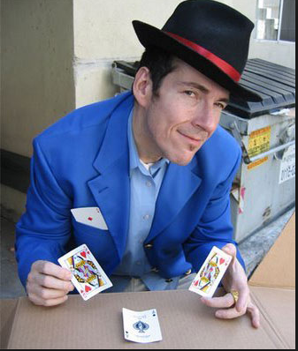
Parting words
When you dive into SEC filings, think about this guy and don’t let him fleece you!
Notes:
If you remember nothing else from this presentation, remember this: there are no accidents in SEC filings. Everything is there for a reason. Finding it is another story!
AMR: new risk factor on pilot retirements. Also new language about lack of financing and encumbrances

