Slide 1
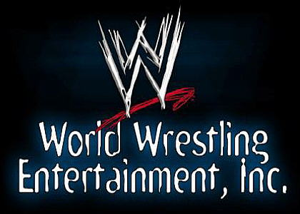
2013

Slide 2
Investment Basics
Easy To Understand
Strong Moat
Strong Balance Sheet
Owner Operator
Generous Dividend
Hidden Asset
Limited Analyst Coverage
Limited Public Float
Temporary Problem

Slide 3
Stock Basics
 | Stock Symbol | WWE
 | Stock Price | $9.90*
 | Class A Shares | 29,771,977
 | Class B Shares** | 45,050,830
 | Market Cap | $741 M
 | Cash | $132 M
 | Debt | $0
 | 52 Week Range | $7.44 - $9.99
 | Dividend Yield | 4.8%
* As of 6/14/2013
** Controlled by the McMahon Family

Slide 4
The Core Business

Slide 5
Company History
1926 - "Toots" Mondt starts “Slam Bang Western Style Wrestling”
1952 - Mondt partners with boxing promoter Jess McMahon to form Capital Wrestling Corp (CWC)
1953 - The CWC pledges to the National Wrestling Alliance (NWA) which coordinated activities between regionally focused groups
1954 - Vince McMahon Sr takes over for his father Jess and builds the CWC into the dominant wrestling promotion in the North East
1963 - McMahon Sr and Mondt leave the NWA and form the World Wide Wrestling Federation (WWWF)
1979 - WWWF renamed World Wrestling Federation WWF
1982 - Vince McMahon Jr. buys the company from his father, secretly planning on abandoning the traditional regional model and building a national wrestling power house. McMahon starts signing all of the biggest regional stars and negotiates television deals, upending the traditional regional model.
1985 - McMahon catapults WWF onto the national stage with Wrestlemania, which incorporated mainstream entertainment with wrestling
focus is “Sports Entertainment“ which incorporates stars from music, sports and film world
1993 - Monday Night Raw is launched as live programming
1999 - IPO 11.5M shares $17
Mid 90's – 2001 - WWE and WCW go head to head and destroy each other's profits
2001 - WWE buys WCW and solidifies their position as the dominant wrestling brand
Key Takeaway: WWE survived a period of brutal competition and emerged as the dominant force in professional wrestling. Other remaining brands are essentially minor league players.

Slide 6
Main Drivers
2012 Revenue: $484M
Live Events / Television
240 – 260 domestic events, 70-80 international events per year
~1,800,000 people attended a live event in 2012
Average Ticket Price $44
6.5 hours of original programming per week.
RAW on USA Network (Replayed on mun2 and Universal HD)
SmackDown on Syfy (Replayed on mun2)
WWE Main Event on Ion
Saturday Morning Slam on The CW
12,000,000 US viewers per week
Pay Per View
10-12 “mega events” per year
$44.95 normal events
$54.95 Wrestlemania
More than 4,000,000 buys in FY`12
Other
Merchandise Sales
Video Games (TTWO replaced THQ)
Online Video ($1.5B YouTube Views)
2012 Profit Contribution

Slide 7
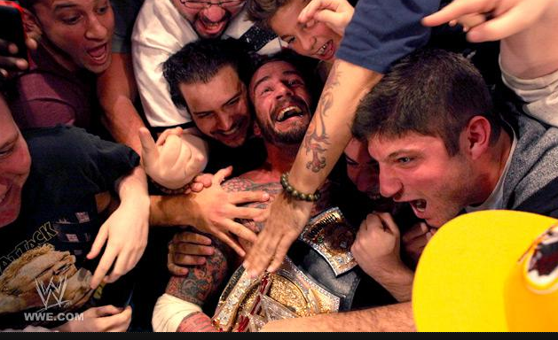
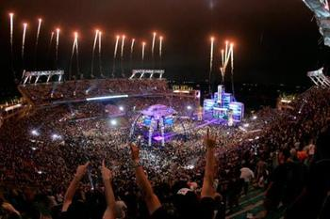
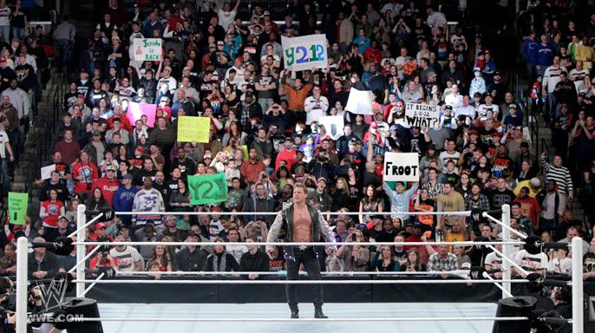
Customer Behavior
Fan: noun \’fan\
an enthusiastic devotee (as of a sport or a performing art) usually as a spectator
An ardent admirer or enthusiast
Probably short for fanatic
Food for thought… How many businesses have customers that paint their faces and make signs before patronizing the business?!?
Source: www.merriam-webster.com

Slide 8
Customer Behavior
Event Cost for a Family of 4
Nascar | $329
NFL | $314
NHL | $244
NBA | $204
Theme Park | $199
WWE | $176
MLB | $108
Movie | $32
Local Opportunities Per Year
Nascar | ?
NFL | 8
NHL | 41
NBA | 41
Theme Park | ∞
WWE | 1-2
MLB | 81
Movie | ∞
No chance to “go to the next game”
Less supply = easier to pass on ticket price increase
Difficult to say how much drops to the bottom line (flat fee vs % of door)
WWE television has a highly attractive demographic making future increases in broadcast rights likely
Prime Time Viewers (000))
Source: MPAA, ISCA, Nielson and WWE Investor Presentation

Slide 9
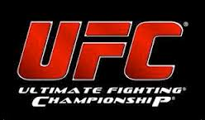
Why is it Cheap?
Perception:
Live Entertainment is Dying
Shift to “social entertainment” (Facebook etc)
New Threats (UFC)
UFC went “main stream” with Griffin vs. Bonnar 1 in April 2005
WWE revenues and core earnings have remained consistent
Poor Comps (ISCA)
Proxy for Nascar
Revenue down 25% from pre crisis peak and forecast to stagnate
WWE revenue down 6% from pre crisis peak and forecast to exceed in 2014
Reality:
Key Metrics are Strong
1.5B YouTube views, 150M Facebook and Twitter followers
Cyclical Element
Events per year varies
Emergence of new stars
New Ventures Obscure the Strength of the Core Business
WWE Studios
WWE Network
Spoiler Alert!
WWE |  | vs |  | UFC
$44 |  | Average Ticket |  | $250+
~10 |  | PPV / Year |  | ~16
~300 |  | Events / Year |  | ~30
Yes |  | Sports Soap Opera? |  | No
No! |  | Real? |  | Yes
Key Takeaway: Worth Keeping an Eye On

Slide 10
What is the Core Business Worth?
 | Normalized EPS / Share | ~.65 - .70
 | Cash Adjusted Average P/E | 17.6x
 | Range | ~$11.44 - $12.32
 | Cash / Share @ 75%* | ~$1.31
 | Intrinsic Value Estimate | ~$12.75- 13.63
 | Current Price | $9.90
 | Implied Upside | 29% - 38%
 |  |  | 2012 | 2011
 | Adjusted Revs |  | 476,113 | 463,021
 | Adjusted Cost of Revs |  | 275,654 | 275,441
 | Adjusted SG&A |  | 124,641 | 105,239
 | Adjusted D&A |  | 15,024 | 14,980
 | Adjusted EBIT |  | 60,794 | 82,341
 | Adjusted EBT |  | 60,283 | 82,203
 | Adjusted Taxes |  | 15,891 | 26,856
 | Adjusted NI |  | 44,392 | 55,347
 | Adjusted EPS |  | 0.60 | 0.75
Vs
 | GAAP EPS |  | 0.42 | 0.33
Average multiple may be too low due to:
Dominant Consumer Brand
Rising Value of Content
Ability to Raise Prices
$0 Debt
Low Maintenance CapEx ($9-$13M ‘08-’12)
Relatively Recession Resistant
High Dividend(Average 70% FCF Payout ‘08-’12)
International Growth
“Average P/E” = 2003-2010 based on annual hi/low price
* Cash / share is shrinking
“Adjusted” = Backing out the effects of losses and investments tied to WWE Studios and a WWE Network

Slide 11
What is the Core Business Worth?
Another Way to Look at Valuation….
[Consistent revenue and a lower than average price to sales can be a sign that management is sacrificing short term profit margins in order to invest for the future.]
~ Kenneth Fisher, Super Stocks
 | 2012 Revenue Net of Film Business(000) | $476,113
 | Fully Diluted Shares (000) | 74,981
 | Rev/Share | $6.35
 | 10 Year Average P/S | 2.11x
 | Intrinsic Value Estimate | $13.40
 | Current Price | $9.90
 | Implied Upside | 35.5%
Paraphrased from Super Stocks, Kenneth Fisher, 2007

Slide 12
The Problem Businesses

Slide 13
Owner Operator - The Strength to Invest for the Future
“Entrepreneurial instinct equates with sizable equity ownership.”
– Martin Sosnoff, Silent Investor, Silent Loser
“Owner-operators put money to work in times of trouble vs agent-operators.”
– See The Outsiders by William Thorndike
The Journal cites a 2003 study of the companies in the S&P500. Family firms as being more profitable than non-family controlled firms. (“In Search of Family Ties”)
McVey and Draho (2005) — Looked at companies controlled by families and found they avoided quarterly earnings guidance, focused on long-term value creation and outperformed their peers.
Lilienfield-Toal and Ruenzi (2009) - Firms in which the CEO voluntarily holds a non-trivial fraction of the company’s stock outperform the market significantly after controlling for traditional risk factors.
Chris Mayer’s Presentation from the Value Investing Congress 5/6/13

Slide 14
Non Core Business: WWE Studios
The Earnings Power of the Core Business is Obscured By WWE Studios
Basic Strategy: Leverage recognizable WWE Superstars into films using free in programming promotion
Strategy makes sense on the surface, but it has been a consistent loser
Title |  | Release Date |  | Production Costs* |  |  | Revenue |  |  | Profit (Loss)
Self - Distributed films
Barricade |  | Sep-12 |  | $4 |  |  | 0.8 |  |  | (3.5)
No Holds Barred |  | Jul-12 |  | — |  |  | 0.4 |  |  | 0.1
Bending the Rules |  | Mar-12 |  | 5.5 |  |  | 0.9 |  |  | (4.7)
The Reunion |  | Oct-11 |  | 6.9 |  |  | 2.1 |  |  | (4.7)
Inside Out |  | Sep-11 |  | 5.1 |  |  | 1.6 |  |  | (3.8)
That's What I Am |  | Apr-11 |  | 4.7 |  |  | 0.9 |  |  | (5.0)
The Chaperone |  | Mar-11 |  | 5.8 |  |  | 4.2 |  |  | (3.8)
Knucklehead |  | Oct-10 |  | 6.4 |  |  | 4.3 |  |  | (4.1)
Legendary |  | Sep-10 |  | 5.3 |  |  | 6.6 |  |  | (2.1)
 |  |  |  | 43.7 |  |  | 21.8 |  |  | (31.6)
Source: 2012 10K

Slide 15
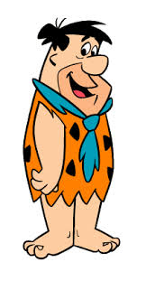
The Solution
Old Strategy: Straight to Walmart
New Strategy: Partner with movie industry pros to make higher quality films, with recognizable main stream stars and WWE stars in supporting roles.
“The Call” 2013 release starring Halle Berry
“Dead Man Down” 2013 release starring Colin Farrell
“Scooby Doo! Legend of Wrestlemania” – 2014 Release
Untitled WWE & Flintstones movie – 2015 Release
If That Doesn’t Work?
“If the new strategy – new film strategy does not work, we probably, in all likelihood, would be out of the film business.”
~ Vince McMahon, CEO – 2/23/12 Q4 2011 conference call
“We're not going to put good money after bad”
~ Vince McMahon, CEO – 2/23/12 Q4 2011 conference call
“While we are confident that our revised approach to filmed entertainment will yield significant returns above our cost of capital, we have also established criteria that will guide our level of participation and potential exit from the business. The future investment will be predicated on the evaluation of our performance in 2013 in this business. “
~ George Barrios, CFO - 2/28/13 Q4 2012 con call

Slide 16
Non Core Business: WWE Network
Earning Power of the Core Business Obscured By Investment in a WWE Network
Basic Strategy: Leverage existing content library and production facilities to make low cost content for a cable channel
Hidden Asset
WWE Owns the Rights to Almost All Video Taped Professional Wrestling Ever Filmed
More than 100,000 Hours
~30% digitally catalogued by SuperStar, technique, theme, etc
Quick and cheap to create new shows
Example “Best of Body Slams” only requires searching the library for body slams
Balance Sheet Value = $0
Hidden Asset is Worth… Less Than Nothing?

Slide 17
Non Core Business: WWE Network
Trouble Getting Off the Ground
Originally…….
…The Latest
“You don't want to start a network unless you have a major partner.”
~Vince McMahon, Q4 2011 Conference Call
“We're going to launch sometime this year. There is no specific date.”
~Vince McMahon, Q4 2011 Conference Call
“Regarding the potential WWE network, we believe that a premium subscription model is the best approach”
~George Barrios, Q4 2012 Conference Call
“We're optimistic, but we're going to get out of predicting dates.“
~George Barrios, Q4 2012
What We Do Know
Proposed price per month $12.99 - $14.99
Includes Some Pay Per View, but Not Wrestlemania
Would Reduce but not Eliminate Cable Programming
Break Even Estimated at 1M Subscribers (Domestic)
Middle of Management’s Range = 3M Subscribers
$130 - $200M Revenue Estimate
Incremental OIBDA $75 - $155M

Slide 18
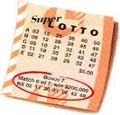
Non Core Business: WWE Network
What We Don’t Know
Will The Network Work??
Impossible to know, but if it does, it will be transformational…
STRZA trades @ ~6x OIBDA… Midpoint of WWE’s network OIBDA guidance at 4x = ~$6/share
Key Take Away: Success of the network is not necessary for an investment in WWE to succeed. If the network is a money loser, the highly incentivized owner operator will shut it down, allowing the strength of the core business to shine through. If the network succeeds, it is a free lotto ticket.
<Q - Michael A. Kupinski>: And so then technically, six months after the launch, you would be determining whether or not you would want to go forward with the launch, is that correct?
<A - George A. Barrios>: Yes, I think in 6 to 12 months you'd have a good idea as, hey, is the current offering working or not. And I think at that point, you have a myriad of decisions to make, but I think you will have a pretty good idea. Q1 2013 Conference Call
“We're not going to put good money after bad”
~ Vince McMahon, CEO – 2/23/12 Q4 2011 conference call

Slide 19
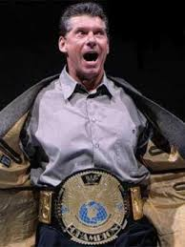
Risks
Do I look like the CEO of a $750M Company?
Management
Highly promotional
Empire building?
History of cutting losses (XFL, Restaurant, etc)
Cannibalization
Not clear how the WWE Network will conflict with existing programming
Dividend Sustainability
Currently out spending FCF
$35.8M spent on dividend in 2012
3 year average FCF of $30M
Large cash cushion
In 2010 and Q1 2011 McMahon family dividend is cut to $.24 while outsiders remained at $.36
2011 entered into unused $200M Senior Unsecured Revolver. Expires September 2013
UFC
Stealing fans?

Slide 20
Summary
At current prices an investment in WWE is an investment in:
A dominant consumer franchise set to benefit from the rising value of content at an approximate 35% discount
A 4.8% dividend yield
A movie business that will either increase earnings or be killed by 2015
A lotto ticket in the form of a TV network that will either increase earnings or be killed by 2015
Key Takeaway: By 2015 WWE will either have greater earnings power or the core business will be allowed to shine through

