Slide 1
Shale Gas - A permanent leftward shift of the supply curve?
Affects upon the Natgas complex
Brian Bosse brianbosse@rogers.com

Slide 2
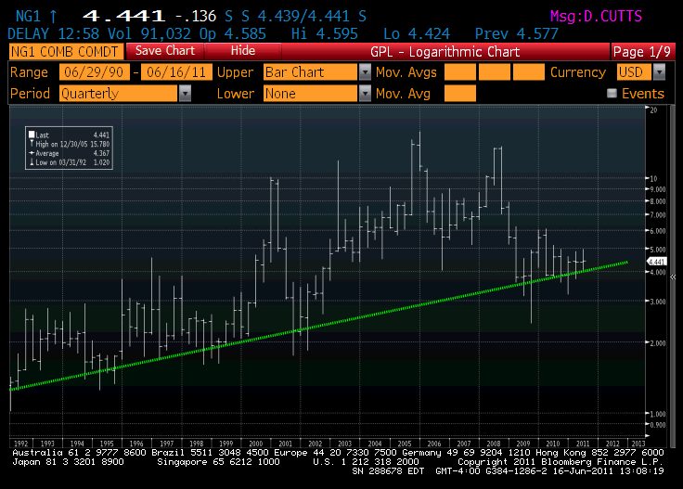

Slide 3
Background
Set the stage – difference between shale gas and conventional lens production.
5 years natural gas chart, list of factors.. Weather 2 ways, leverage, lease requirements, forward sales and capex. And the belief that shale gas is abundant, endless, cheap production. Ergo low prices will not cure low prices because this time its different!

Slide 4
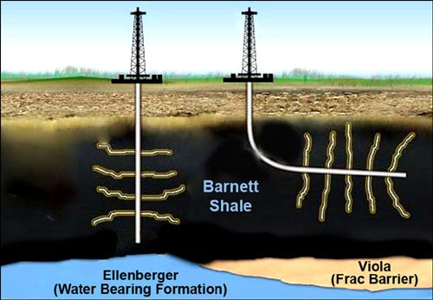
2 technology advances in the past decade

Slide 5
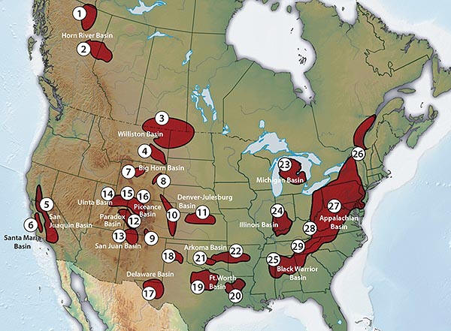

Slide 6
Signs that it is NOT different
Encana [chessboard centre] refuses to roll forward hedges because market price is too low.
Rig count now falling (adjusted for new tech).
Shale wells have higher initial flows then decay rate.
Gas is so cheap, it becomes an oil substitute.
No pumping.
Still needs piping to markets
Politics of water tables trumps permits… PA township, 60 minutes, Quebec.
Export licence granted to LNG in La.

Slide 7
So What?
Money to be made as natgas is rerated upwards from everyone knows that stuff is dead money...
I am looking for the inflection moment in gas prices, producer valuations, assets on balance sheets, earnings, stock prices.
For investors who are interested in commodities, but not “in”, viola!

Slide 8
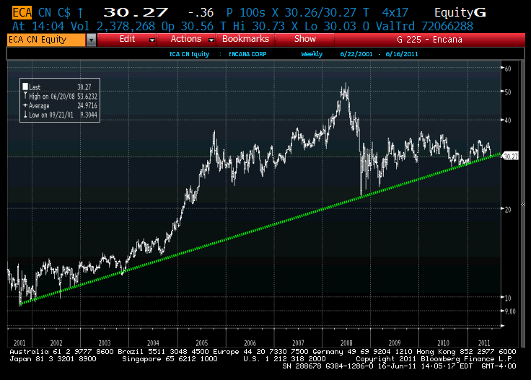

Slide 9
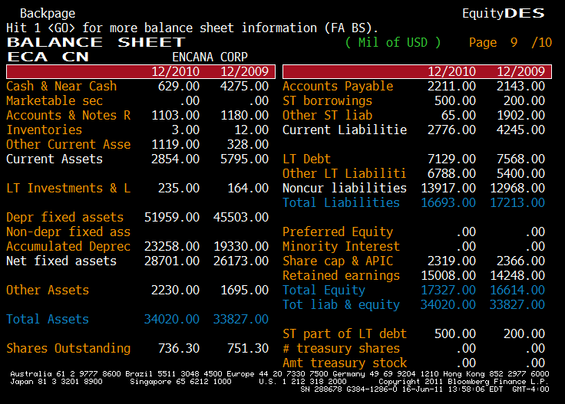

Slide 10
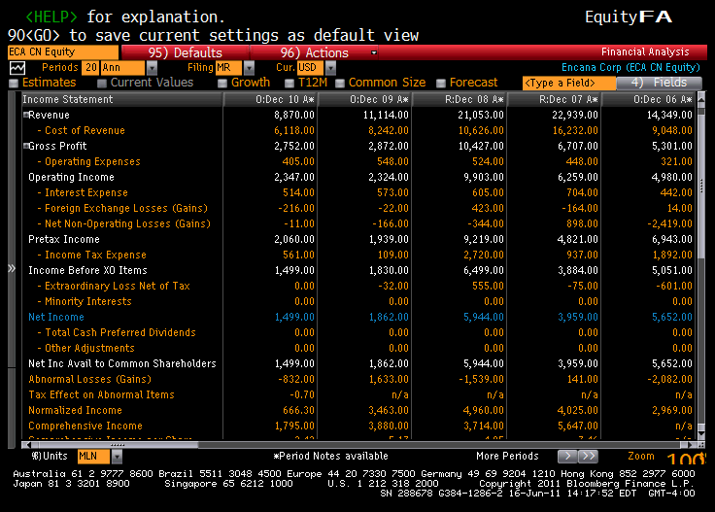

Slide 11
Questions

